Slide 1
Steps in the Writing process
By Aris

Slide 2
prewriting
5 steps in the writing process
drafting
Revising
editing
finishing

Slide 3
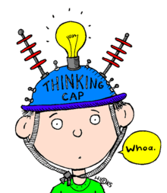
PREWRITING
Prewriting is when you get your thoughts straight.
You can also jot down some words .

Slide 4
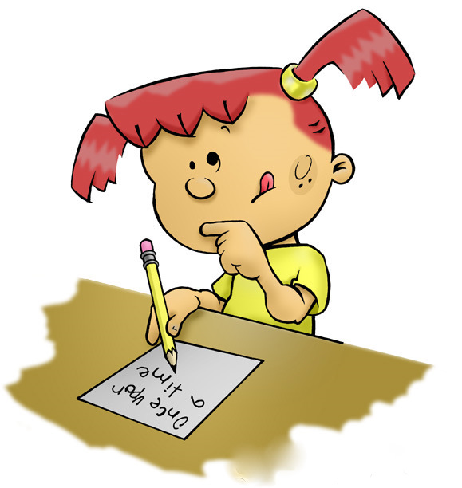
Drafting
Putting your ideas on paper.

Slide 5
Revising
Making your writing stronger.

Slide 6
editing
Correcting errors

Slide 7
finishing
Present your work.

