Slide 1
The steps in the writing process
By:Janiyah howard

Slide 2
The five steps in the writing process
prewriting
drafting
revising
editing
Finishing
publishing

Slide 3
The first step is prewriting
prewriting is thinking about what to write

Slide 4
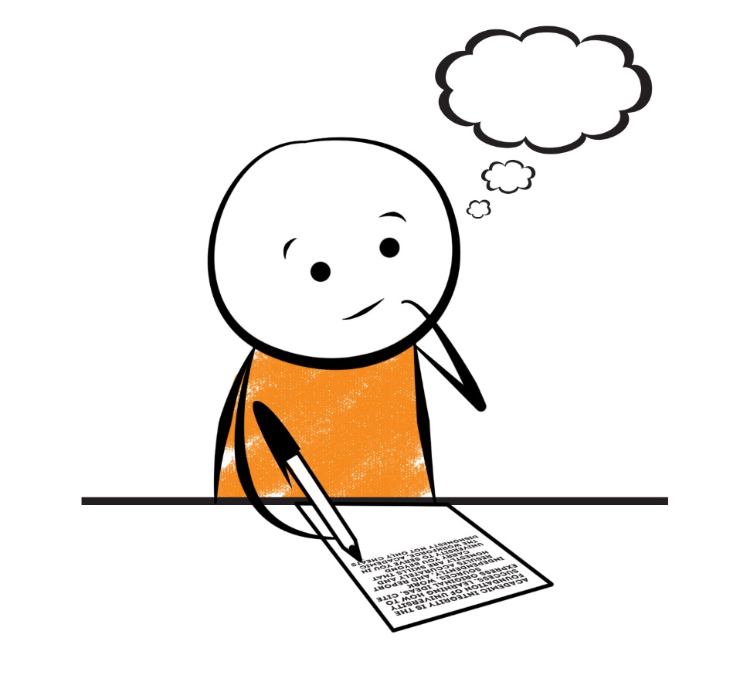
drafting
Drafting is making your paragrahpe

Slide 5
revising
Revising is making better words

Slide 6
editing
Editing is making sure everything is good

Slide 7
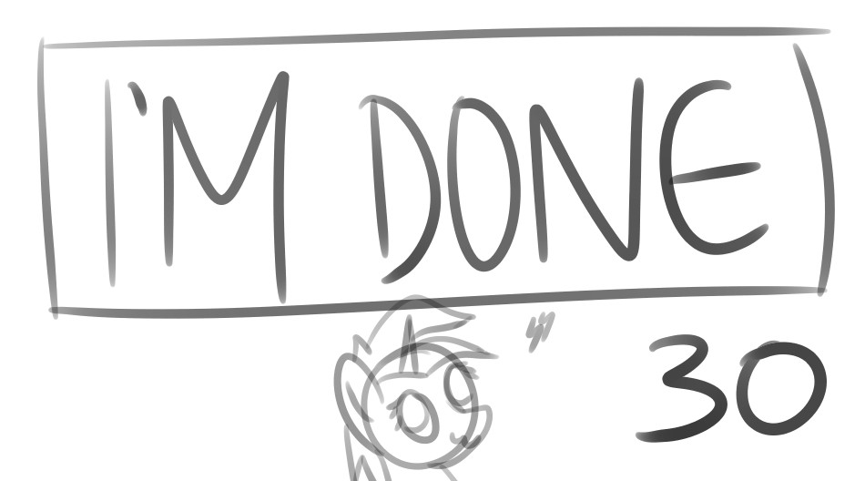
Finishinging and publishing
Finshing and publishing is to show the audence

