Slide 1
Steps in the writing process:
By: Ralyn Carter

Slide 2
There are 5 steps in the writing process
Prewriting
drafting
revising
editing
Finishing
publishing

Slide 3
prewriting
Prewriting is to writing more ideas.

Slide 4
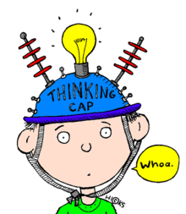
Revising
Revising is a bigger word.

Slide 5
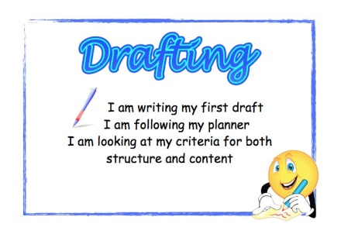
drafting
.
Drafting mean you are writing a paragraph.

Slide 6
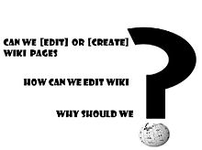
editing
Editing is to cheek the work

Slide 7
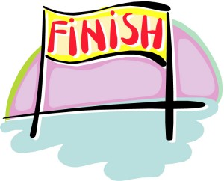
Finishing publishing
Finishing and publishing is to mean you are finish.

