Slide 1
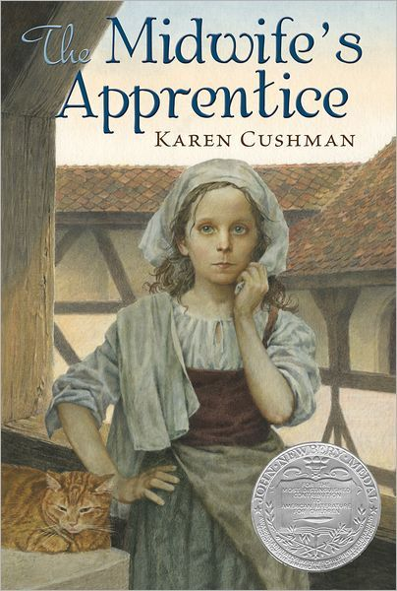
The Midwife’s Apprentice Newbery book report
Author : Karen Cushman
Book report by :Sylvia Hurley
Won the Newbery award in :1996

Slide 2
These are the main characters
.Brat/Beetle/Alyce
.Jane the Midwife
.Purr

Slide 3
Brat/Beetle/Alyce
I am going to tell you about Alyce. Alyce has 2 other names through out the book. For about the first 2 paragraphs she is called Brat. After that she is called Beetle for about 3 or 4 more chapters. But for most of the book she is called Alyce. Alyce is an unsure, slightly insecure girl about the age of 13. For example on page 21 after she is dragged into the miller’s cottage to help his wife give birth she says, “I cannot I am to sore afraid.” I think Alyce is a great role model because at the end she becomes confident and secure.

Slide 4
Jane the Midwife
Jane is a sour, strict woman. She gives Alyce 3 small meals a day. She defiantly isn’t the nicest person in the world. An example would be on page 19 while helping the weaver’s wife Kate deliver her baby she used comments like, “Push you cow.” and,” If an animal can do it you can to.” I think Jane could definitely be nicer because if she were nicer she would have friends.

Slide 5
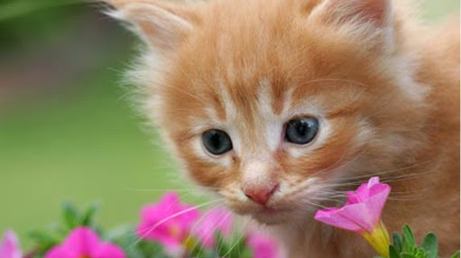
Purr
Now to talk about the final main character Purr. Purr is a cat. He is a good listener for Alyce. I think that listening is a good character trait. I like the Cat because he has that trait. For example on page 10 it said “Alyce told him what she could remember of her life before the found each other, and they fell asleep in the sun.”

Slide 6
The settings
. The streets
. Jane’s cottage
. John Dark’s place

Slide 7
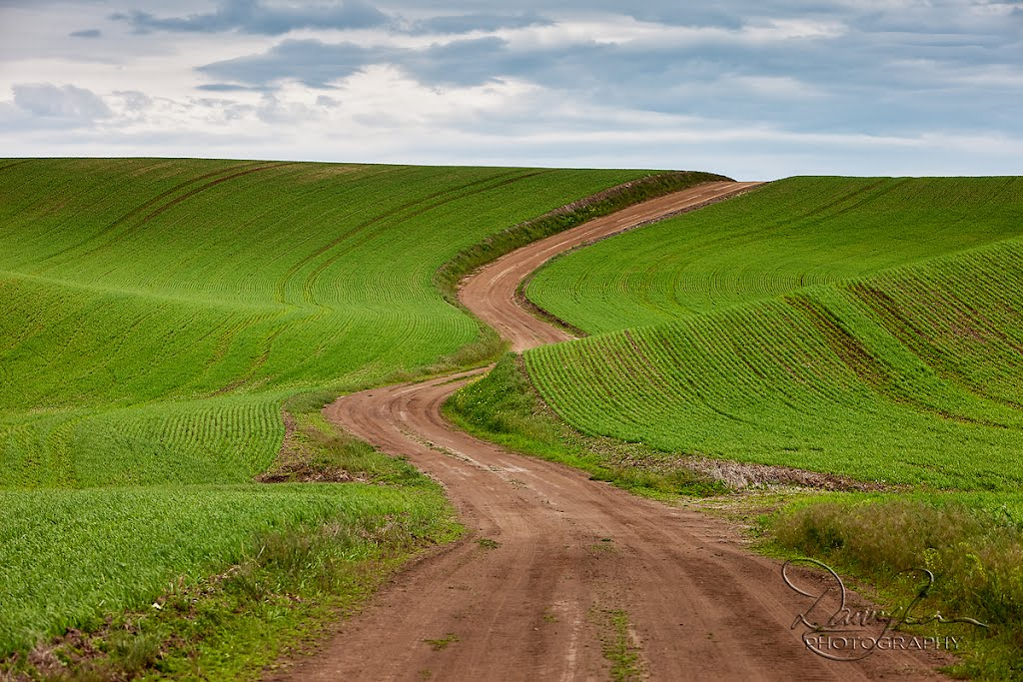
The streets
The streets are made of dirt. On some parts you can’t look left or right without seeing green luscious fields. On other parts there’s nothing but empty gray fields. Sometimes you see a cottage or two. I think the streets match Alyce perfectly because sometimes she was happy like the green fields, and other times she was sad like the gray fields.

Slide 8
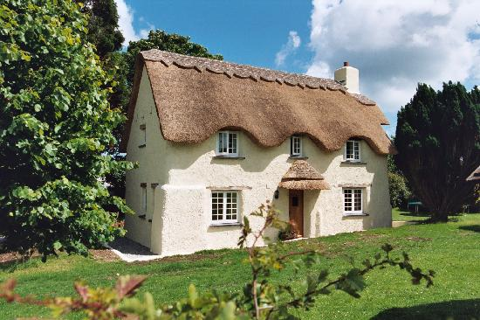
Jane’s cottage
Jane’s cottage is small but cozy. Most of the shelves are filled to the brim with glass jars covered in leather. The floor is made of dirt, so you have to throw water on it then stomp on it to solidify it. I think I would like to live in Jane’s cottage. I also think Jane’s cottage fits in perfectly with the story because without her cottage the story just wouldn’t seem finished.

Slide 9
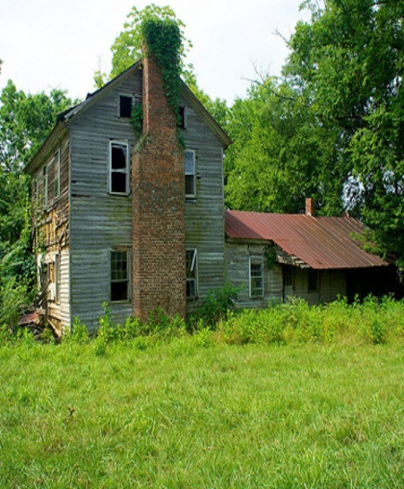
John Dark’s Place
John Dark’s place is a very important setting in the story. It is very important because that is were Alyce finds her confidence. John Dark’s Place is an inn. The inn is really nothing more than a stone cottage with a room over the big kitchen. I think John Dark’s Place is the most important setting in the entire book because without it Alyce would never have found her confidence.

Slide 10
How Unity and Disunity took place in this book
Unity and disunity were a big part of my book. Disunity happened when Alyce was rejected and ignored by the villagers. Unity happened after Alyce delivered Joan the bailiff’s wife’s baby. She was then accepted and welcomed into the community. So in my book unity and disunity were both incorporated.

Slide 11
Summery In the beginning…
the book was actually dull and boring. That just made me want to read more to see if it would get better. The book started off describing Alyce. How she looked about 12 or 13. How she had no name in her life but Brat.

Slide 12
Summary As the story began to unfold…
you learned what Alyce’s life is like. “She watched in the windows as Jane the midwife did her work.”[page 53] You saw that Alyce did not have much courage. ”Alyce took the taunting's in silence.”[page 44] That quote shows Alyce doesn’t have much courage because she let herself be taunted.
Notes:
il

Slide 13
Summary In the end…
Alyce found her courage. She stood up for her self and Purr. “You touch that cat again and I will unstop this bottle of rats blood and vipers flesh and summon the Devil who will turn you into women You will giggle like women and dress like women and give birth like women!” [page 87] Even though the vile was only filled with blackberry cordial that quote proves Alyce grew.

Slide 14
Conclusion
In conclusion I liked The Midwife’s Apprentice. I would recommend the book as long as you have a very high tolerance for weird and awkward and you are a GIRL, because there are some pretty weird and awkward part’s and if you were a guy the weird and awkwardness would be multiplied by 50. The genre is historical fiction. I think the book won because it is an example of the moral, ”Confidence strikes courage.”
P.S. I came up with that moral by myself because it suites the book perfectly in my opinion.

